Slide 1
Next Generation:
IPv6

Slide 2
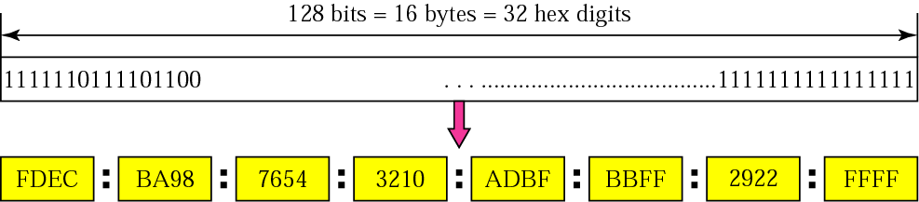
IPv6 address

Slide 3
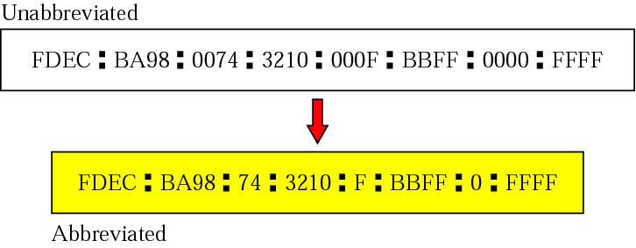
Abbreviated address

Slide 4
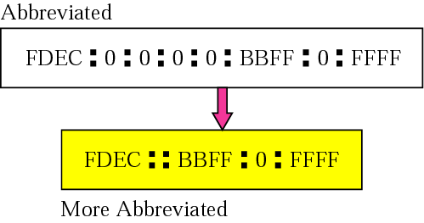
Abbreviated address with consecutive zeros

Slide 5

CIDR address

Slide 6
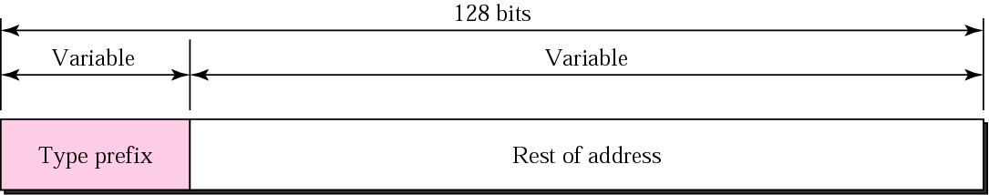
Address structure

Slide 7
Type prefixes for IPv6 addresses
Type Prefix | Type | Type Prefix | Type
0000 0000 | Reserved | 010 | Provider-based unicast addresses
0000 0001 | Reserved | 100 | Geographic unicast addresses
0000 001 | NSAP (N/w Service Access Point) | 101 | Reserved
0000 010 | IPX (Novell) | 110 | Reserved
0000 011 | Reserved | 1110 | Reserved
0000 100 | Reserved | 1111 0 | Reserved
0000 101 | Reserved | 1111 10 | Reserved
0000 110 | Reserved | 1111 110 | Reserved
0000 111 | Reserved | 1111 1110 0 | Reserved
0001 | Reserved | 1111 1110 10 | Link local addresses
001 | Reserved | 1111 1110 11 | Site local addresses
011 | Reserved | 1111 1111 | Multicast addresses

Slide 8
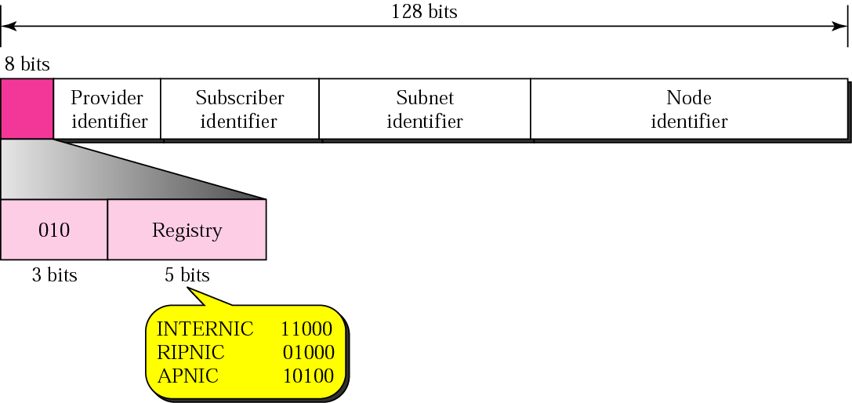
Provider-based address

Slide 9
Provider-based address (Contd.)
Type identifier
3-bit
Specifies the type prefix
Registry identifier
5-bit
Registry centers
Currently 3 have been defined
INTERNIC (11000) for North America
RIPNIC (01000) for European countries
APNIC (10100) for Asian and Pacific countries
Provider identifier
Variable-length
Identifies ISP
16-bit length is recommended

Slide 10
Provider-based address (Contd.)
Subscriber identifier
Variable-length
Identifies the organization subscribed to Internet through a provider
24-bit length is recommended
Subnet identifier
Variable-length
Identifies the subnet under the territory of subscriber
32-bit length is recommended
Node identifier
Variable-length
Identifies the node in a subnet
48-bit length is recommended to make it compatible with the 48-bit link (physical) address used by Ethernet.

Slide 11
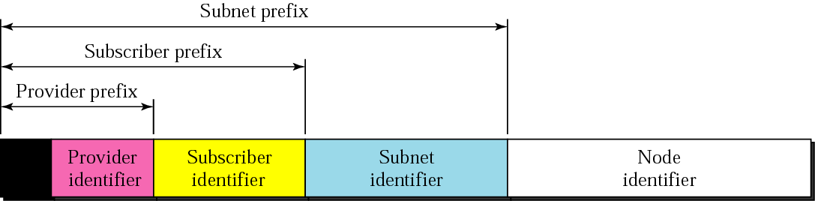
Address hierarchy

Slide 12
Reserved Addresses use reserved prefix(0000 0000)

Slide 13
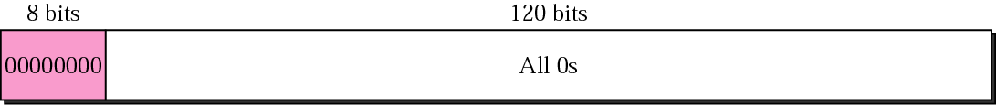
Unspecified address
used when host doesn’t know its own address and sends an inquiry to find it.

Slide 14
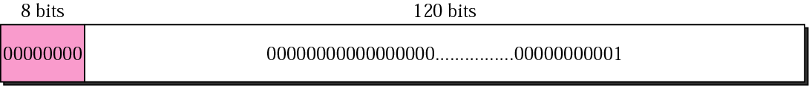
Loopback address
Used by a host to test itself without going into the network

Slide 15
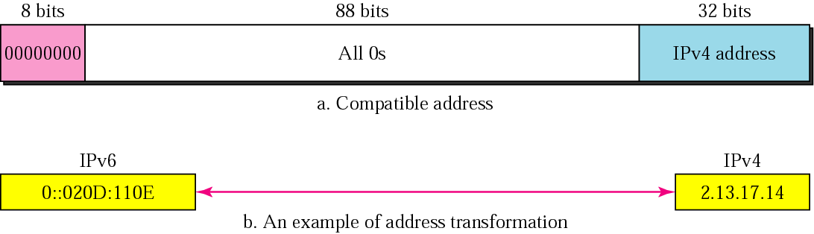
IPv4 addresses – Compatible address
Used when source and destination hosts both are using IPv6 but intermediate nodes might using IPv4

Slide 16
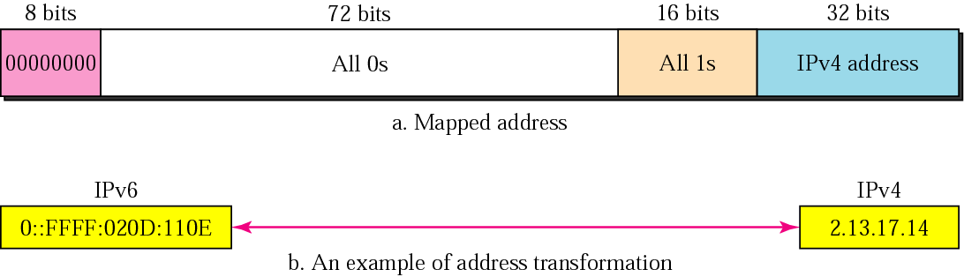
IPv4 addresses – mapped address
Used when one of the host running IPv6 and another running IPv4.

Slide 17
Local Addresses

Slide 18
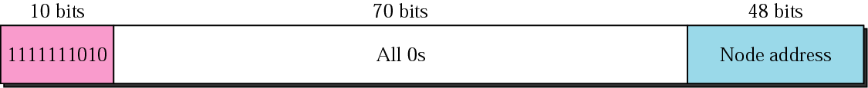
Link local address
Used if LAN uses IP but is not connected to the Internet for Security reasons.
used in an isolated network where nobody outside an isolated network can send a message to the computers attached to a network using these addresses

Slide 19
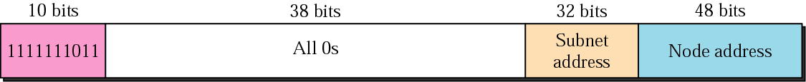
Site local address
Used if site with several networks uses IP but is not connected to the Internet for Security reasons.

Slide 20
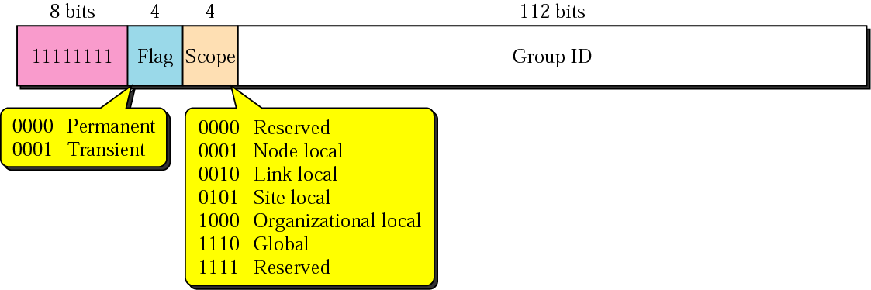
Multicast addresses
used to define group of hosts
Flag defines group address as Permanent or Transient
Permanent group address is defined by Internet Authorities
Transient used temporarily ex. Systems engaged in a teleconference

Slide 21
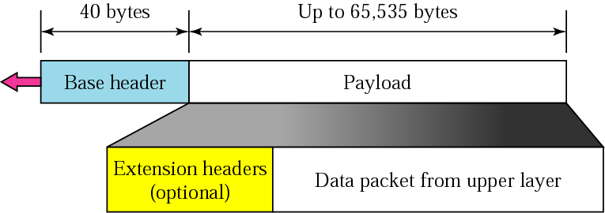
IPv6 datagram

Slide 22
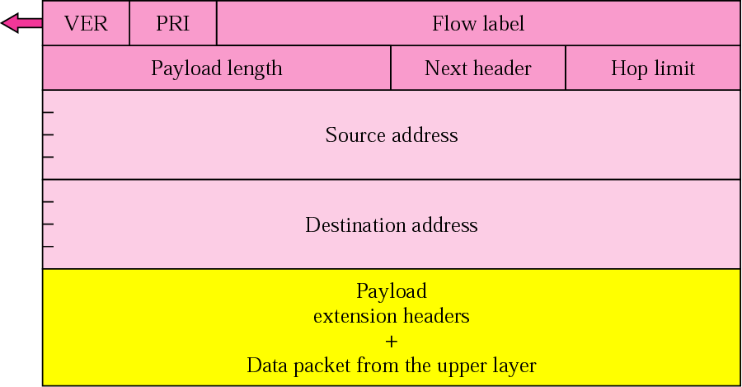
Format of an IPv6 datagram

Slide 23
Version
4 bit
for IPv6 the value is 6
Priority
4-bit
defines the priority of packet
similar to DS field of IPv4
Flow label
24-bit
provides special handling for particular flow of data
ex. Real-time audio and video
Payload length
16-bit
specifies the length of IP datagram excluding base header
Next header
8-bit
defines the header that follows base header
similar to protocol field of IPv4
Hop limit
8-bit
similar to TTL field in IPv4
Source address (16 bytes-128 bit)
Destination address (16 bytes-128 bit)

Slide 24
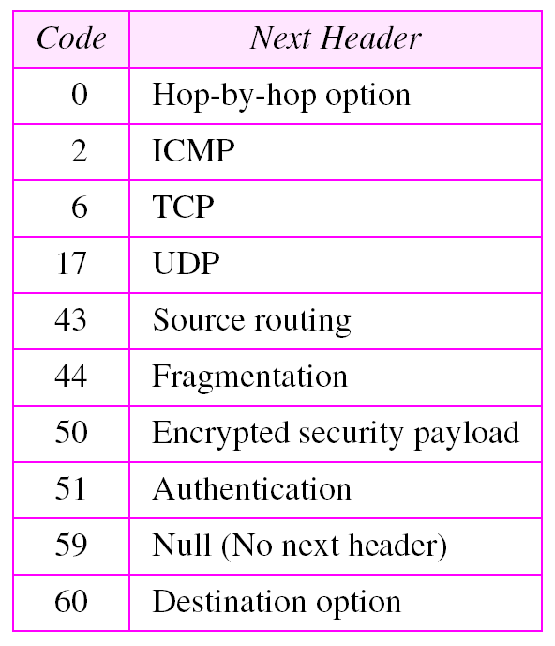
Next header codes

Slide 25
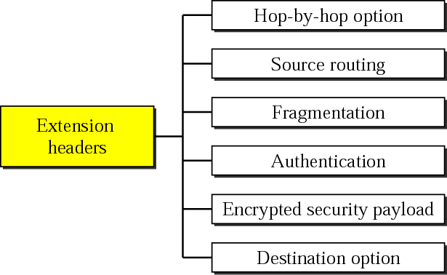
Extension Header type

Slide 26
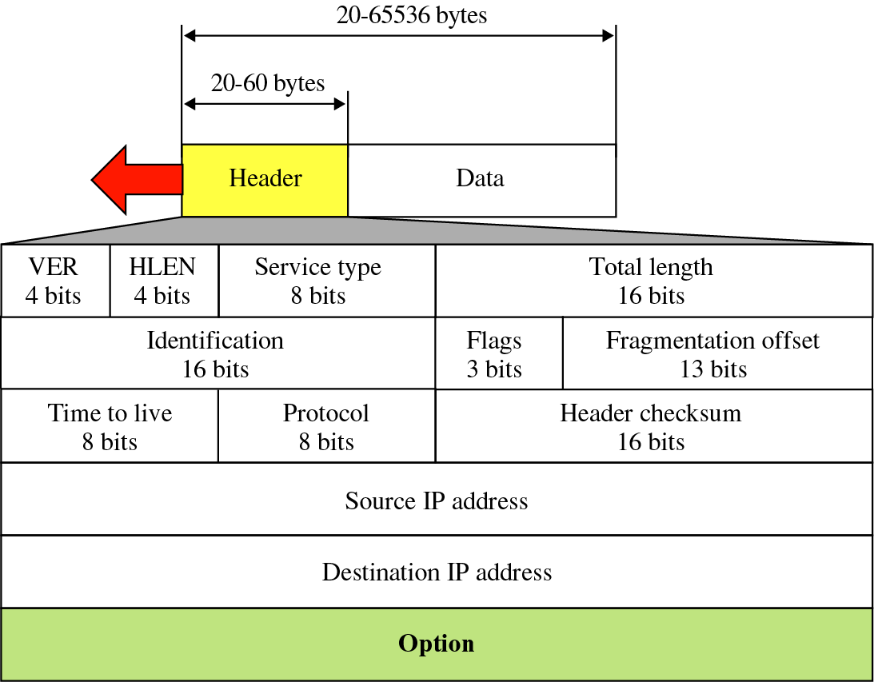
IPv6datagram
See the difference between IPv4 & IPv6 datagram
IPv4 datagram

Slide 27
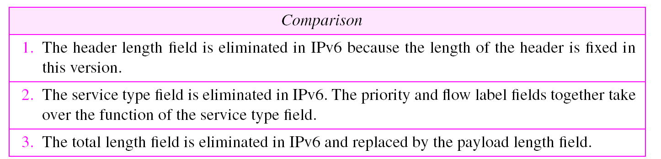
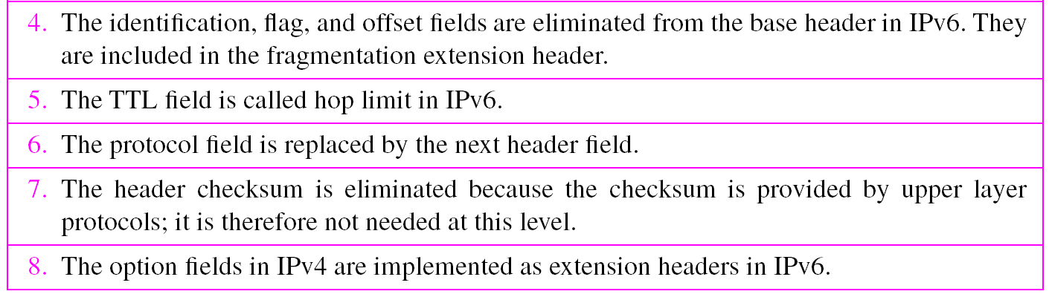
Comparison between IPv4 and IPv6 packet header
(40 bytes)

Slide 28
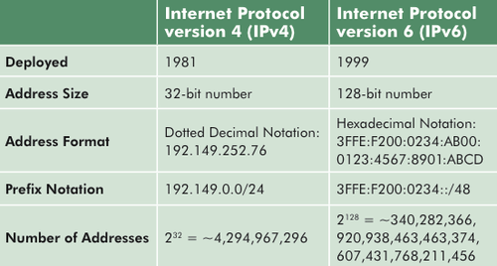
IPv4 vs IPv6

